Slide 1
Core Spring

Slide 2
Developing Aspects With Spring AOP
Chapter 8

Slide 3
Objectives
Explain the concepts behind AOP and the problem that it solves
Implement and deploy Advice using Spring
Use AOP Pointcut Expressions
Explain the 5 different Types of Advice
  And when to use them

Slide 4
Chapter Topics
What Problem Does AOP Solve?
Leading AOP Technologies
Core AOP Concepts
Case Study
Defining Pointcuts
Implementing Advice
Named Pointcuts (Optional)
Context Selecting Pointcuts (Optional)
Working with Annotations (Optional)
Advice Order (Optional)
Limitations Of Spring AOP
Summary
References
Review
Lab

Slide 5
If AOP Is The Cure, What's The Disease?
Aspect-Oriented Programming (AOP) enables the modularization of cross-cutting concerns
  Well, I'm glad we cleared that up ;-)

Slide 6
What Are Cross Cutting Concerns?
Generic functionality that is needed in many places in your application
  Logging and Tracing
  Transaction Management
  Security
  Caching
  Error Handling
  Performance Monitoring
  Business Rules
  https://en.wikipedia.org/wiki/Cross-cutting_concern

Slide 7
How Do You Know Something Is A Cross Cutting Concern?
When your functional requirements include terms like “every”, “always”, “never”, or equivalent all-encompassing terms

Slide 8
Implementing Cross Cutting Concerns Without Modularization
Failing to modularize cross cutting concerns leads to
  Code Tangling
    A coupling of concerns resulting in a loss of cohesiveness
  Code Scattering
    The same concern is spread across several modules, resulting in duplication

Slide 9
Code Tangling
public class RewardNetworkImpl implements RewardNetwork {
public RewardConfirmation rewardAccountFor(Dining dining) {
if (!hasPermission(SecurityContext.getPrincipal()) {
throw new AccessDeniedException();
}
Account a = accountRepository.findByCreditCard(...);
Restaurant r = restaurantRepository.findByMerchantNumber(...);
MonetaryAmount amt = r.calculateBenefitFor(account, dining);
...
}
}
In the example illustrated above, note how the security related code is intertwined with the business logic, making them difficult to separate should you ever want to use one without the other

Slide 10
Code Scattering
public class HibernateAccountManager implements AccountManager {
public Account getAccountForEditing(Long id) {
if (!hasPermission(SecurityContext.getPrincipal()) {
throw new AccessDeniedException();
}
...
}
...
}
In the example illustrated above, note how the security related code is replicated in many classes, resulting in bloat, and redundant maintenance
public class HibernateMerchantReportingService
implements MerchantReportingService {
public List<DiningSummary> findDinings
(String merchantNumber, DateInterval interval) {
if (!hasPermission(SecurityContext.getPrincipal()) {
throw new AccessDeniedException();
}
...
}
...
}

Slide 11
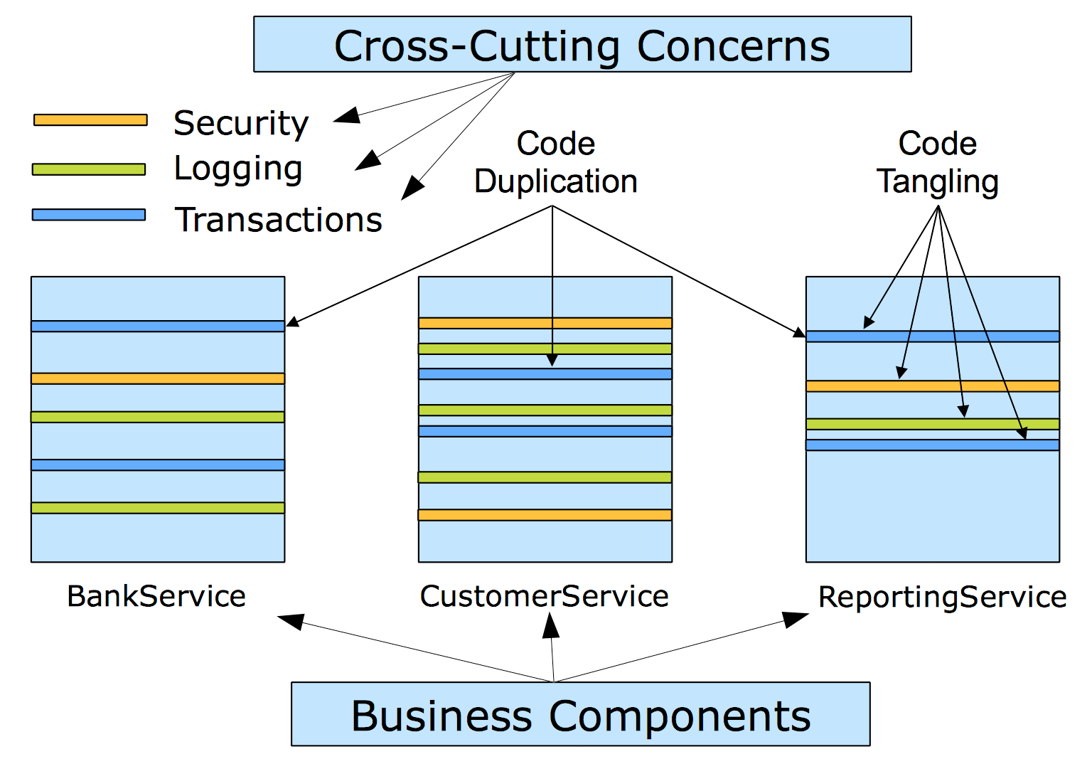
System Evolution Without Modularization

Slide 12

Couldn't We Implement Cross Cutting Concerns In A Utility Class?
Yes, but such an implementation would still result in the need to
  Invoke methods on the utility class
  Modify the component dependent on the utility class each time a cross cutting concern is added or removed
  Eliminates the scattering, but not the tangling

Slide 13
Aspect Oriented Programming (AOP)
Aspect-Oriented Programming (AOP) enables modularization of cross cutting concerns, eliminating both code
  Tangling
  Scattering

Slide 14

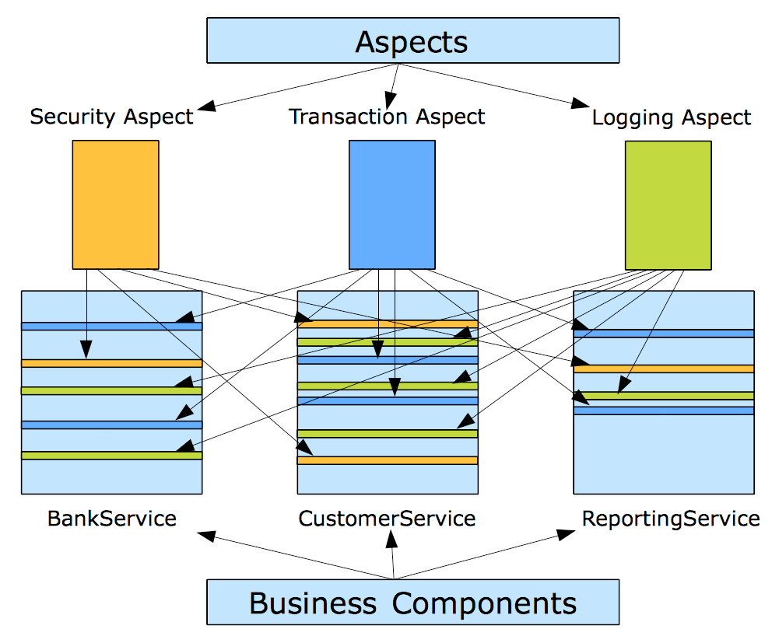
System Evolution With Modularization

Slide 15
AOP Provides 3 Benefits: Decoupling, Decoupling And Decoupling
The business component is unaware of the presence of any cross cutting concerns
  So cross cutting concerns can be added or removed without having to modify the component benefiting from their presence
The cross cutting concern is typically unaware of the business component
  So the cross cutting concern is typically reusable across a variety of business components and contexts
The client is unaware of the presence of any cross cutting concerns
  So cross cutting concerns can be added or removed without having to modify the client benefiting from their presence

Slide 16
Chapter Topics
What Problem Does AOP Solve?
Leading AOP Technologies
Core AOP Concepts
Case Study
Defining Pointcuts
Implementing Advice
Named Pointcuts (Optional)
Context Selecting Pointcuts (Optional)
Working with Annotations (Optional)
Advice Order (Optional)
Limitations Of Spring AOP
Summary
References
Review
Lab

Slide 17
Leading AOP Technologies
AspectJ
  Original AOP technology (first version in 1995)
  Offers a complete Aspect Oriented Programming language
  Uses byte code modification for aspect weaving
Spring AOP
  Java-based AOP framework with AspectJ integration support
  Supports interface or inheritance based proxies
    Uses CGLib for inheritance based proxies
    Uses Java dynamic proxies for interface based proxies
  Supports the AspectJ Pointcut expression language

Slide 18
AspectJ Vs. Spring AOP
AspectJ Advantages
  Performance
    AOP implementations that employ byte code weaving (like AspectJ) run about 35 times faster than those that employ dynamic proxies
  Greater compile time flexibility
    Cross cutting concerns can be wrapped around individual statements, not just method calls
    Can advise final methods
    Can advise intra-object method calls
    Can advise POJOs, not just Spring beans
Spring AOP Advantages
  Simpler programming model
    No external compiler/weaver required
  Greater runtime flexibility
    Different advice could be applied to different instances of the same class

Slide 19
Chapter Topics
What Problem Does AOP Solve?
Leading AOP Technologies
Core AOP Concepts
Case Study
Defining Pointcuts
Implementing Advice
Named Pointcuts (Optional)
Context Selecting Pointcuts (Optional)
Working with Annotations (Optional)
Advice Order (Optional)
Limitations Of Spring AOP
Summary
References
Review
Lab

Slide 20
Core AOP Concepts
Target
  A business component to which cross cutting concerns apply, consisting of 1+
Joinpoint(s)
  A method (in Spring AOP) of the target to which a cross cutting concern is applied from an
Aspect
  A component that provides a cross cutting concern, consisting of
Advice
  A method of an Aspect that applies the cross cutting concern to a Joinpoint based on a
Pointcut
  A regular expression that identifies the Joinpoints to which Advice is to be applied, in a process known as
Weaving
  The process by which Aspects are combined with Targets

Slide 21
Core AOP Concepts: A Visual Representation
Spring AOP Proxy
Client
Proxy Interceptor
Legend
  Target
  Joinpoint
  Aspect
  Advice
  Pointcut
Aspect
Pointcut
Advice
Target
Joinpoint
Joinpoint

Slide 22
Chapter Topics
What Problem Does AOP Solve?
Leading AOP Technologies
Core AOP Concepts
Case Study
Defining Pointcuts
Implementing Advice
Named Pointcuts (Optional)
Context Selecting Pointcuts (Optional)
Working with Annotations (Optional)
Advice Order (Optional)
Limitations Of Spring AOP
Summary
References
Review
Lab

Slide 23
How You Write Code Using AOP
Implement your mainline application logic
  Focusing on the core problem, as though AOP did not exist
Implement your cross cutting concerns
  Spring provides many aspects out-of-the-box
Weave the cross cutting concerns into your application
  Applying the cross cutting concerns to your application logic at the right places

Slide 24
AOP Case Study: AOP Logger
Application Requirement
  Log access to properties of an object
How would you use AOP to meet this challenge?

Slide 25
Warning
The example in the courseware is in one respect a confusing example
The object called a SimpleCache is the target, NOT the Aspect, despite the fact that in an earlier slide, the author suggested that a cache was a cross cutting concern (Aspect)
Of course, in the author's defense, a cache could also be a target of an aspect, which is the case in this example, where it is the target of a logging aspect

Slide 26
Implement The Target
public interface Cache {
public void setCacheSize(int size);
}
public class SimpleCache implements Cache {
private int cacheSize;
private String name;
public SimpleCache(String beanName) {
name = beanName;
}
public void setCacheSize(int size) {
cacheSize = size;
}
public String toString() {
return name;
}
}
Target
Joinpoint

Slide 27
Implement The Aspect
@Aspect
@Component
public class PropertyChangeTracker {
private Logger logger = Logger.getLogger(getClass());
@Before("execution(void set*(*))")
public void trackChange() {
logger.info("Property about to change ...");
}
}
Note the presence of both the @Aspect and @Component annotations
  @Aspect is not a @Component stereotype
    It is not component scanned
    So to register it as a Spring bean you will need to declare it as a Spring bean using any of the styles Spring supports
      Java based configuration
      Annotation based configuration
      XML based configuration
      Via the FactoryBean interface
Aspect
Pointcut Expression
Advice

Slide 28
Configure The Aspect As A Spring Bean
@Configuration
@EnableAspectJAutoProxy
@ComponentScan(basePackages="com.example.aspects")
public class AspectConfig {
...
}
Because Spring strives to be lightweight, as is true for other Spring services, AOP services are not provided unless specifically enabled
  Using @EnableAspectJAutoProxy
Note also the need to enable Component Scanning on the factory, so that Spring can find the Component class

Slide 29
Include The Aspect Configuration As Part Of The Application Configuration
@Configuration
@Import(AspectConfig.class)
public class MainConfig {
@Bean
public Cache cacheA() {
return new SimpleCache("cacheA");
}
@Bean
public Cache cacheB() {
return new SimpleCache("cacheB");
}
@Bean
public Cache cacheC() {
return new SimpleCache("cacheC");
}
}

Slide 30
Run The Application
package sample;
import org.springframework.boot.SpringApplication;
import org.springframework.boot.autoconfigure.SpringBootApplication;
import org.springframework.context.ApplicationContext;
public class Main {
public static void main(String[] args) {
ApplicationContext applicationContext =
SpringApplication.run(Main.class);
Cache cache = (Cache) applicationContext.getBean("cacheA");
cache.setCacheSize(2500);
}
}

Slide 31
Recall The Decoupling Benefits Of AOP
Review the source code components
  Is there any awareness of the presence of the cross cutting concern in the business component?
  Is there any awareness of the business component in the cross cutting concern
  Is there any awareness of the presence of the cross cutting concern in the client?
  The answer to all of these questions is NO!

Slide 32
How The Aspect Is Applied
3. All calls routed
through proxy
interceptor
2. Proxy implements
Target interface(s)
<<interface>>
Cache
Spring AOP Proxy (this)
Method
Interceptor
SimpleCache
(target)
SimpleCache
(target)
setCacheSize(2500)
SimpleCache
(Target)
PropertyChangeTracker
(Aspect)
5. Target method
is executed
1. Spring creates a
proxy 'weaving'
aspect & target
4. Matching advice
is executed

Slide 33
Which Method Is Proxied?
public interface Cache {
public void setCacheSize(int size);
}
public class DatabaseCache implements Cache {
private int cacheSize;
private DataSource dataSource;
private String name;
public SimpleCache(String beanName) // Constructors not
{ name = beanName; } // proxied in Spring AOP
public void setCacheSize(int size) // Yes, part of interface
{ cacheSize = size; }
public void setDataSource(DataSource ds) // No, not part of
{ dataSource = ds; } // interface
public String toString()
{ return name; }
}

Slide 34
Aspects With Context (1 Of 2)
Earlier, I made a big deal about the 3 forms of decoupling AOP provides
But that decoupling is not always a good thing
  e.g. The logging Aspect illustrated in the previous example does not provide very useful information
For this reason, it is not uncommon to eschew decoupling in advice methods

Slide 35
Aspects With Context (2 Of 2)
Context is provided by the Joinpoint parameter, representing the method being invoked
@Aspect
@Component
public class PropertyChangeTracker {
private Logger logger = Logger.getLogger(getClass());
@Before("execution(void set*(*))")
public void trackChange(JoinPoint point) {
String methodName =
point.getSignature().getName();
Object newValue = point.getArgs()[0];
logger.info(methodName + " about to change to " +
newValue + " on " +
point.getTarget());
}
}
INFO: setCacheSize about to change to 2500 on cacheA

Slide 36
Chapter Topics
What Problem Does AOP Solve?
Leading AOP Technologies
Core AOP Concepts
Case Study
Defining Pointcuts
Implementing Advice
Named Pointcuts (Optional)
Context Selecting Pointcuts (Optional)
Working with Annotations (Optional)
Advice Order (Optional)
Limitations Of Spring AOP
Summary
References
Review
Lab

Slide 37
Defining Pointcuts
Spring supports a subset of AspectJ Pointcut expression language
  A regular expression language for “weaving” aspect advice methods to target Joinpoint methods
You can even chain designators together in to create composite pointcut expressions using operators like && (and), || (or), and ! (not)

Slide 38
Pointcut Expression Syntax (1 Of 2)
A Spring AOP pointcut expression consists of:
  A mandatory designator
  Optional modifiers
  A mandatory return type specification
  A mandatory Joinpoint method specification
  A mandatory parameter specification
  Optional Exception specifications
Modifiers
Return Type
Parameters
execution(public * rewards.restaurant.*Service.find*(..) throws IOException)
Designator
Package
Type
Methods
Exceptions

Slide 39
Pointcut Expression Syntax (2 Of 2)
Modifier specification (Optional)
  Typically used to specify annotation requirements of a Joinpoint
Return type specification (Mandatory)
  Recognized metacharacters
    * - Matches any return type (including void)
    + - Matches any interface or classtype
Method specification (Mandatory including the parameter designator)
  May optionally include package and class identifiers
  Recognized metacharacters
    * - Matches any characters or types, once
    + - Matches any interface or classtype, once
    .. - Matches any characters or types, zero or more times
    *.. - Matches any leading package, zero or more times
Exception specification (Optional)
  Recognized metacharacters
    * - Matches any Exception type once

Slide 40
What Does The Following Pointcut Expression Match? (1 Of 2)
execution(void send*(String))

Slide 41
What Does The Following Pointcut Expression Match? (2 Of 2)
execution(void send*(String))
  Any Joinpoint method whose return type is void, whose name starts with send, that takes a single String in its parameter list

Slide 42
What Does The Following Pointcut Expression Match? (1 Of 2)
execution(* send(*))

Slide 43
What Does The Following Pointcut Expression Match? (2 Of 2)
execution(* send(*))
  Any Joinpoint method regardless of its return type (including void methods), named send, that takes a single argument of any type in its parameter list

Slide 44
What Does The Following Pointcut Expression Match? (1 Of 2)
execution(void send*(rewards.Dining))

Slide 45
What Does The Following Pointcut Expression Match? (2 Of 2)
execution(void send*(rewards.Dining))
  Any Joinpoint method whose return type is void, whose name starts with send, that takes a single argument of type rewards.Dining in its parameter list

Slide 46
What Does The Following Pointcut Expression Match? (1 Of 2)
execution(* send(int, ..))

Slide 47
What Does The Following Pointcut Expression Match? (2 Of 2)
execution(* send(int, ..))
  Any Joinpoint method regardless of return type, named send, whose first parameter is an int

Slide 48
What Pointcut Expression Would You Use To ... (1 Of 2)
Match any Joinpoint method regardless of return type, named send, containing an int parameter anywhere in its argument list?

Slide 49
What Pointcut Expression Would You Use To ... (2 Of 2)
Match any Joinpoint method regardless of return type, named send, containing an int parameter anywhere in its argument list?
  execution(* send(.., int, ..))

Slide 50
What Does The Following Pointcut Expression Match? (1 Of 2)
execution(void example.MessageServiceImpl.*(..))

Slide 51
What Does The Following Pointcut Expression Match? (2 Of 2)
execution(void example.MessageServiceImpl.*(..))
  Any Joinpoint method whose return type is void, from the class named example.MessageServiceImpl, regardless of its method name, regardless of its parameter requirements
  Note that this same pointcut expression would also match an equivalent method of any subclass of the target, example.MessageServiceImpl

Slide 52
What Does The Following Pointcut Expression Match? (1 Of 2)
execution(void example.MessageService.send(*))

Slide 53
What Does The Following Pointcut Expression Match? (2 Of 2)
execution(void example.MessageService.send(*))
  Any Joinpoint method whose return type is void, that implements the example.MessageService interface, whose name is send, that takes a single argument of any type in its parameter list
  This option is more flexible than its predecessor, in the same way that interfaces are more flexible than inheritance

Slide 54
What Does The Following Pointcut Expression Match? (1 Of 2)
execution(@javax.annotation.security.RolesAllowed void send*(..))

Slide 55
What Does The Following Pointcut Expression Match? (2 Of 2)
execution(@javax.annotation.security.RolesAllowed void send*(..))
  Any Joinpoint method annotated with @javax.annotation.security.RolesAllowed, whose return type is void, whose name starts with send, regardless of its parameter requirements
  One neat application of this would be to create your own annotations, using them in pointcut expressions like the one illustrated above to limit the Joinpoints to which advice would be applied
public interface Mailer {
@RolesAllowed("USER")
public void sendMessage(String text);
}

Slide 56
What Pointcut Expression Would You Use To ... (1 Of 2)
Match any Joinpoint method of any class?

Slide 57
What Pointcut Expression Would You Use To ... (2 Of 2)
Match any Joinpoint method of any class?
  execution(* *(..))

Slide 58
What Does The Following Pointcut Expression Match? (1 Of 2)
execution(* rewards.*.restaurant.*.*(..))

Slide 59
What Does The Following Pointcut Expression Match? (2 Of 2)
execution(* rewards.*.restaurant.*.*(..))
  Any Joinpoint method regardless of its return type, of any class of the restaurant subpackage, of any single subpackage of the rewards package, regardless of its parameter requirements
    Matches
      rewards.california.restaurant.chezpanisse.foigras
    Does not match
      rewards.california.berkeley.restaurant.chipotle.burrito

Slide 60
What Does The Following Pointcut Expression Match? (1 Of 2)
execution(* rewards..restaurant.*.*(..))

Slide 61
What Does The Following Pointcut Expression Match? (2 Of 2)
execution(* rewards..restaurant.*.*(..))
  Any Joinpoint method regardless of its return type, of any class of the restaurant subpackage, anywhere beneath the rewards package, regardless of its parameter requirements
    Matches
      rewards.restaurant.chezpanisse.foigras
      rewards.california.restaurant.chezpanisse.foigras
      rewards.california.alameda.restaurant.chezpanisse.foigras

Slide 62
What Does The Following Pointcut Expression Match? (1 Of 2)
execution(* *..restaurant.*.*(..))

Slide 63
What Does The Following Pointcut Expression Match? (2 Of 2)
execution(* *..restaurant.*.*(..))
  Any Joinpoint method regardless of its return type, of any class of the restaurant subpackage, of any package, regardless of its parameter requirements
    Matches
      rewards.restaurant
      refunds.california.restaurant
      rewards.us.california.alameda.restaurant

Slide 64
What Does The Following Pointcut Expression Match? (1 Of 2)
execution(* *..restaurant.*(..))

Slide 65
What Does The Following Pointcut Expression Match? (2 Of 2)
execution(* *..restaurant.*(..))
  Any Joinpoint method regardless of its return type, of a class named restaurant, of any package, regardless of its parameter requirements
    This is likely to match nothing in most applications, since the convention in Java is to capitalize class names

Slide 66
Additional Pointcut Designators
execution
  Matches methods based on AspectJ Pointcut expressions
  The primary Pointcut designator you will use
this
  Limits matching to Joinpoint methods whose proxy is an instance of a given type
target
  Limits matching to Joinpoint methods whose target is an instance of a given type
args
  Limits matching to Joinpoint methods whose arguments are instances of a given type
within
  Limits matching to Joinpoint methods coming from a given package

Slide 67
Chapter Topics
What Problem Does AOP Solve?
Leading AOP Technologies
Core AOP Concepts
Case Study
Defining Pointcuts
Implementing Advice
Named Pointcuts (Optional)
Context Selecting Pointcuts (Optional)
Working with Annotations (Optional)
Advice Order (Optional)
Limitations Of Spring AOP
Summary
References
Review
Lab

Slide 68
Advice Types
Spring supports 5 types of advice
  Before
  AfterReturning
  AfterThrowing
  After
  Around

Slide 69
Advice Type: Before
Before advice executes before entering the matching Joinpoint method
Proxy
BeforeAdvice
Target

Slide 70
Advice Type: Before Example
Use Before advice for preprocessing
  Note that if the advice method throws an Exception, the Joinpoint method will not be invoked
  The example illustrated above logs an impending state change
Demonstration: AOPBefore
@Aspect
public class PropertyChangeTracker {
private Logger logger = Logger.getLogger(getClass());
@Before("execution(void set*(*))")
public void trackChange() {
logger.info("Property about to change...");
}
}

Slide 71
Advice Type: AfterReturning
AfterReturning advice executes after returning successfully (without throwing an Exception) from the matching Joinpoint method
Proxy
AfterReturningAdvice
Target
Successful Return

Slide 72
Advice Type: AfterReturning Example
Use AfterReturning advice for postprocessing
  The “returning” attribute provides the advice method access to the return value via the corresponding method parameter
  The return value must also be compatible with the corresponding parameter type, or the advice method will not be invoked
  The example illustrated above logs the value returned from the matching Joinpoint method
Demonstration: AOPAfterReturning
@AfterReturning
(value="execution(* service..*.*(..))",
returning="reward")
public void audit(JoinPoint jp, Reward reward) {
auditService.logEvent(jp.getSignature() +
" returns the following reward object : "
+ reward.toString() );
}

Slide 73
Advice Type: AfterThrowing
AfterThrowing advice executes after returning unsuccessfully (by throwing an Exception) from the matching Joinpoint method
Proxy
AfterThrowingAdvice
Target
Unsuccessful Return

Slide 74
Advice Type: AfterThrowing Example (1 Of 2)
Use the AfterThrowing advice for Exception postprocessing
  The “throwing” attribute provides the advice method access to the Exception via the corresponding method parameter
  The Exception must also be compatible with the corresponding parameter type, or the advice method will not be invoked
  The example illustrated on the next page logs the exception thrown from the matching Joinpoint method

Slide 75
Advice Type: AfterThrowing Example (2 Of 2)
Demonstration: AOPAfterThrowing
@AfterThrowing
(value="execution(* *..Repository.*(..))", throwing="e")
public void report(JoinPoint jp, DataAccessException e) {
mailService.emailFailure("Exception in repository", jp, e);
}

Slide 76
AfterThrowing Advice Propagation
AfterThrowing advice will not stop an exception from propagating back to the caller
  To stop exception propagation completely, use Around advice
  However an AfterThrowing advice method can throw a different type of exception back to the caller
    e.g. Catching a checked Exception, but throwing a RuntimeException
@AfterThrowing
(value="execution(* *..Repository.*(..))", throwing="e")
public void report(JoinPoint jp, DataAccessException e) {
mailService.emailFailure("Exception in repository", jp, e);
throw new RewardsException(e);
}

Slide 77
Advice Type: After
After advice executes after returning from the matching Joinpoint method, regardless of whether the method succeeded or failed
  Making it a good candidate for general purpose cleanup
Proxy
AfterAdvice
Target

Slide 78
Advice Type: After Example
Use After advice for general purpose postprocessing
Demonstration: AOPAfter
Demonstration: AOPAfterAll
@Aspect
public class PropertyChangeTracker {
private Logger logger = Logger.getLogger(getClass());
@After("execution(void update*(..))")
public void trackUpdate() {
logger.info("An update has been attempted ...");
}
}

Slide 79
Advice Type: Around
Around advice executes both before entering and after exiting the matching Joinpoint method, making it ideal for
  Preprocessing
  Postprocessing
  Overcoming limits applicable to other forms of Advice
Proxy
AroundAdvice
Target
proceed()

Slide 80
Advice Type: Around Example
Use Around advice for anything
  It can do anything the other forms of advice can do
  It can do many things the other forms of advice cannot do
  It does, however, required a bit more work on the part of the Aspect writer, because it requires explicit method forwarding and return value handling, implicit to other forms of advice
Demonstration: AOPAround
Demonstration: AOPAroundCache
@Around("execution(@example.Cacheable * rewards.service..*.*(..))")
public Object cache(ProceedingJoinPoint point) {
Object value = cacheStore.get(cacheKey(point));
if (value == null) {
value = point.proceed();
cacheStore.put(cacheKey(point), value);
}
return value;
}

Slide 81
Capabilities Of Around Advice
Among the special capabilities of Around advice are the abilities to
  Retry failed Joinpoint methods
  Prevent an Exception from propagating back to the caller
  Simultaneously provide preprocessing, postprocessing and error handling, all from a single advice method
  Modify arguments to Joinpoint methods
    Other forms of advice can modify the properties of those arguments, but not the arguments themselves
  Modify return values of Joinpoint methods
    Other forms of advice can modify the properties of those return values, but not the return values themselves

Slide 82
Chapter Topics
What Problem Does AOP Solve?
Leading AOP Technologies
Core AOP Concepts
Case Study
Defining Pointcuts
Implementing Advice
Named Pointcuts (Optional)
Context Selecting Pointcuts (Optional)
Working with Annotations (Optional)
Advice Order (Optional)
Limitations Of Spring AOP
Summary
References
Review
Lab

Slide 83
Named Pointcuts
Pointcut expressions can be named
  Facilitates reuse
  Makes code more readable
The example above defines 2 named pointcuts
  Like a Spring bean, the method name becomes the pointcut id
@Aspect
public class PropertyChangeTracker {
private Logger logger = Logger.getLogger(getClass());
@Before("serviceMethod() || repositoryMethod()")
public void monitor() {
logger.info("A business method has been accessed ...");
}
@Pointcut("execution(* rewards.service..*Service.*(..))")
public void serviceMethod() {}
@Pointcut("execution(* rewards.repository..*Repository.*(..))")
public void repositoryMethod() {}
}

Slide 84
Externalizing Named Pointcuts
Named pointcuts are often externalized to a reusable utility class
package com.acme;
public class Pointcuts {
@Pointcut("execution(* rewards.service..*Service.*(..))")
public void serviceMethods() {}
}
@Aspect
public class ServiceMethodInvocationMonitor {
private Logger logger = Logger.getLogger(getClass());
@Before("com.acme.Pointcuts.serviceMethods()")
public void monitor() {
logger.info("A service method has been accessed ...");
}
}

Slide 85
Named Pointcuts Summary
Named pointcuts
  Allow you to break a single, complicated expression into multiple subexpressions
  Faciliate pointcut expression reuse
Best practice
  Consider externalizing expressions into one dedicated class
    When working with many pointcuts
    When writing complicated expressions

Slide 86
Chapter Topics
What Problem Does AOP Solve?
Leading AOP Technologies
Core AOP Concepts
Case Study
Defining Pointcuts
Implementing Advice
Named Pointcuts (Optional)
Context Selecting Pointcuts (Optional)
Working with Annotations (Optional)
Advice Order (Optional)
Limitations Of Spring AOP
Summary
References
Review
Lab

Slide 87
Context Selecting Pointcuts
Pointcut designators may also be used to select useful Joinpoint “context”
  target: The target object
  args: Method arguments
  within: Package membership
  this: The currently executing proxy object
  Annotations associated with the method, target, or arguments
The idea behind these designators is to simplify the specification of advice methods (just as named pointcuts do)
  Think of them as “syntactic sugar”

Slide 88
Case Study
Consider the following basic requirement
  Log a message every time a server is about to start
The question is, within the advice method, how would you access
  The Server itself
  The Map representing its argument list?
public interface Server {
public void start(Map input);
public void stop();
}

Slide 89
Without Context Selection
To satisfy this requirement without Context Selection, all of the necessary information would have to be obtained directly from JoinPoint itself
  In ways likely to require extra code to deal with issues like
    Type safety
    The presence of required arguments
@Before("execution(void example.Server.start(java.util.Map))")
public void logServerStartup(JoinPoint jp) {
// A 'safe' implementation would also check target type
Server server = (Server) jp.getTarget();
// Don't assume args[0] exists
Object [] args= jp.getArgs();
Map map = args.length > 0 ? (Map) args[0] : new HashMap();
logger.info(server + " Starting with Params: " + map);
}

Slide 90
With Context Selection
To satisfy this requirement with Context Selection, much of the necessary information could be obtained instead from the Pointcut designators
  In ways that eliminate the need to deal directly with issues like
    Type safety
    The presence of required arguments
In the example illustrated below
  The target(server) designator selects the target, as though you had typed
  While the args(input) designator handles parameter declarations, as though you had typed
@Before("execution(void example.Server+.start(java.util.Map)) && target(server) && args(input)")
public void logServerStartup(Server server, Map input) { ... }
Server server = (Server) jp.getTarget();
Object [] args= jp.getArgs();
Map map = args.length > 0 ? (Map) args[0] : new HashMap();

Slide 91
Context Selection Also Works With Named Pointcuts
@Pointcut("execution(void example.Server+.start(java.util.Map)) && target(server) && args(input)")
public void serverStartMethod (Server server, Map input) {}
@Before("serverStartMethod(server, input)")
public void logServerStartup(Server server, Map input) { ... }

Slide 92
Chapter Topics
What Problem Does AOP Solve?
Leading AOP Technologies
Core AOP Concepts
Case Study
Defining Pointcuts
Implementing Advice
Named Pointcuts (Optional)
Context Selecting Pointcuts (Optional)
Working with Annotations (Optional)
Advice Order (Optional)
Limitations Of Spring AOP
Summary
References
Review
Lab

Slide 93
Pointcut Expressions Using Annotations
Pointcut expressions can match annotations everywhere
  Annotated classes
  Annotated methods
  Methods with annotated arguments
  Methods returning annotated objects
execution(@org..transaction.annotation.Transactional * *(..))
  Any method marked with the @Transactional annotation
execution( (@example.Sensitive *) *(..))
  Any method that returns a type marked as @Sensitive
@Sensitive public class MedicalRecord { ... }
public class MedicalService {
public MedicalRecord lookup(...) { ... }
}

Slide 94
AOP And Annotations
Below is an example of using the annotation() designator as an alternative to including the @Transactional (illustrated in the previous slide) in the execution designator
@Around("execution(* *(..)) && @annotation(txn)")
public Object execute
(ProceedingJoinPoint jp, Transactional txn) {
TransactionStatus tx;
try {
TransactionDefinition defintion =
new DefaultTransactionDefinition();
definition.setTimout(txn.timeout());
definition.setReadOnly(txn.readOnly());
...
tx = txnMgr.getTransaction(definition);
return jp.proceed();
}
... // commit or rollback
}

Slide 95
AOP And Annotations With Named Pointcuts
The example illustrated below is identical to its predecessor in the previous slide, but uses a Named Pointcut
@Around("transactionalMethod(txn)")
public Object execute
(ProceedingJoinPoint jp, Transactional txn) { ... }
@Pointcut("execution(* *(..)) && @annotation(txn)")
public void transactionalMethod(Transactional txn) {}

Slide 96
Chapter Topics
What Problem Does AOP Solve?
Leading AOP Technologies
Core AOP Concepts
Case Study
Defining Pointcuts
Implementing Advice
Named Pointcuts (Optional)
Context Selecting Pointcuts (Optional)
Working with Annotations (Optional)
Advice Order (Optional)
Limitations Of Spring AOP
Summary
References
Review
Lab

Slide 97
Food For Thought
What if ...
  You have multiple advice methods with overlapping (or even the same) pointcut expressions
    So they all apply to a particular Joinpoint
  They need to execute in a particular order
    Which, while not a recommended practice, is sometimes necessary
How do you enforce advice ordering?

Slide 98
Advice Order
@Aspect
@Order(2)
public class BeforeAdviceA {
@Before("execution(* aop.demo.BusinessClass.*1*(..))")
public void log() {
System.out.println("Inside Before AdviceA");
}
}
In the example illustrated above, BeforeAdviceB will execute first
@Aspect
@Order(1)
public class BeforeAdviceB {
@Before("execution(* aop.demo.BusinessClass.*1*(..))")
public void log() {
System.out.println("Inside Before AdviceB");
}
}

Slide 99
Chapter Topics
What Problem Does AOP Solve?
Leading AOP Technologies
Core AOP Concepts
Case Study
Defining Pointcuts
Implementing Advice
Named Pointcuts (Optional)
Context Selecting Pointcuts (Optional)
Working with Annotations (Optional)
Advice Order (Optional)
Limitations Of Spring AOP
Summary
References
Review
Lab

Slide 100
Limitations Of Spring AOP
Spring AOP only advises non-private JoinPoints
Interface based Spring AOP only proxies methods appearing in the interface
Inheritance based Spring AOP methods cannot be final
Spring AOP only applies aspects to Spring beans
  Not to ordinary POJOs
Spring AOP advice is applied at the boundaries of methods, not within methods
  Unlike AspectJ which can apply them anywhere
Some Spring AOP designators and pointcuts are more computationally expensive than others
  So choose carefully when there is more than one suitable designator
The Surprise Factor!
  Remember, Spring AOP is usually transparent to your application code, which is not always a good thing
Spring AOP is not always transparent to your design
  References to “this” bypass the proxies
    AOP can be affected by the use of “this”

Slide 101
Chapter Topics
What Problem Does AOP Solve?
Leading AOP Technologies
Core AOP Concepts
Case Study
Defining Pointcuts
Implementing Advice
Named Pointcuts (Optional)
Context Selecting Pointcuts (Optional)
Working with Annotations (Optional)
Advice Order (Optional)
Limitations Of Spring AOP
Summary
References
Review
Lab

Slide 102
Summary
Aspect Oriented Programming (AOP) modularizes thte handling of cross cutting concerns
An aspect is a module (Java class) containing the cross cutting behavior
  Annotated with @Aspect
  Behavior is implemented in the form of “advice” methods
  Pointcuts select Joinpoints (methods) where advice applies
  Spring AOP supports five types of advice
    Before
    AfterReturning
    AfterThrowing
    After
    Around

Slide 103
Chapter Topics
What Problem Does AOP Solve?
Leading AOP Technologies
Core AOP Concepts
Case Study
Defining Pointcuts
Implementing Advice
Named Pointcuts (Optional)
Context Selecting Pointcuts (Optional)
Working with Annotations (Optional)
Advice Order (Optional)
Limitations Of Spring AOP
Summary
References
Review
Lab

Slide 104
References
http://docs.spring.io/spring/docs/current/spring-framework-reference/htmlsingle/#aop
http://docs.codehaus.org/display/AW/AOP+Benchmark

Slide 105
Chapter Topics
What Problem Does AOP Solve?
Leading AOP Technologies
Core AOP Concepts
Case Study
Defining Pointcuts
Implementing Advice
Named Pointcuts (Optional)
Context Selecting Pointcuts (Optional)
Working with Annotations (Optional)
Advice Order (Optional)
Limitations Of Spring AOP
Summary
References
Review
Lab

Slide 106
Review
AOP enables the modularization of __________________

Slide 107
Review Answer
AOP enables the modularization of cross cutting concerns

Slide 108
Review
List 3 examples of cross cutting concerns

Slide 109
Review Answer
List 3 examples of cross cutting concerns
  Logging and Tracing
  Transaction Management
  Security
  Caching
  Error Handling
  Performance Monitoring

Slide 110
Review
Failing to modularize cross cutting concerns leads to what 2 problems?

Slide 111
Review Answer
Failing to modularize cross cutting concerns leads to what 2 problems?
  Tangling
  Scattering

Slide 112
Review
What 3 forms of decoupling does AOP provide?

Slide 113
Review Answer
What 3 forms of decoupling does AOP provide?
  The business component is unaware of the presence of any cross cutting concerns
    So cross cutting concerns can be added or removed without having to modify the component benefiting from their presence
  The cross cutting concern is typically unaware of the business component
    So the cross cutting concern is typically reusable across a variety of business components and contexts
  The client is unaware of the presence of any cross cutting concerns
    So cross cutting concerns can be added or removed without having to modify the client benefiting from their presence

Slide 114
Review
Match the term to its definition
Term
Target
Advice
Joinpoint
Pointcut
Aspect
Proxy
Definition
An object that intercepts method calls to apply advice
A kind of regular expression that identifies the Joinpoints to which advice will be applied
A method that implements a cross cutting concern
An object that binds pointcuts with advice
The method(s) (in Spring AOP) of the target to which advice will be applied
A business component

Slide 115
Review Answer
Match the term to its definition
Term
Target
Advice
Joinpoint
Pointcut
Aspect
Proxy
Definition
An object that intercepts method calls to apply advice
A kind of regular expression that identifies the Joinpoints to which advice will be applied
A method that implements a cross cutting concern
An object that binds pointcuts with advice
The method(s) (in Spring AOP) of the target to which advice will be applied
A business component

Slide 116
Review
Which of the following are mandatory in a pointcut expression?
  Modifiers
  Return type
  Class type
  Method name pattern
  Method argument pattern
  Exception type
  Package name

Slide 117
Review Answer
Which of the following are mandatory in a pointcut expression?
  Modifiers
  Return type
  Class type
  Method name pattern
  Method argument pattern
  Exception type
  Package name

Slide 118
Review
What are the 5 types of advice supported by Spring?

Slide 119
Review Answer
What are the 5 types of advice supported by Spring?
  Before
  AfterReturning
  AfterThrowing
  After
  Around

Slide 120
Review
Which of the following are true for Spring AOP? (Choose all that apply)
  Can only advise public JoinPoints (Spring AOP)
  Can only apply aspects to Spring beans
  Advice is applied at the boundaries of methods, not within methods
  Only works with interfaces
  Is transparent to design

Slide 121
Review Answer
Which of the following are true for Spring AOP? (Choose all that apply)
  Can only advise public JoinPoints (Spring AOP)
  Can only apply aspects to Spring beans
  Advice is applied at the boundaries of methods, not within methods
  Only works with interfaces
  Is transparent to design

Slide 122
Review
Providing 1 letter each, what phrase introduced in this chapter is represented below?
_ _ _ _ _ _ _ _ _ _ _ _ _ _ _ _ _ _

Slide 123
Review Answer
Providing 1 letter each, what phrase introduced in this chapter is represented below?
P O I N T C U T E X P R E S S I O N

Slide 124
Chapter Topics
Test Driven Development
JUnit 5
Integration Testing With Spring
Testing With Profiles
Testing With Databases
Unit Testing With Stubs And Mocks (Optional)
Summary
References
Review
Lab

Slide 125
Lab
Lab : Developing Aspects With Spring AOP
  Eclipse Project
    08-aop
  Instructions
    Introducing Aspect Oriented Programming
  Completion Time
    45 Minutes

